Slide 1
Ready Reckoner - COVID-19 Crisis Communication Chatbot
Team Name: Tech Genius

Slide 2



Idea Description(Short)
Idea Id: 3363
Theme: Covid-19 Crisis Communication
Team Name: Tech Genius
Challenge/ Scenario
Solution Approach
In times of crisis, communications systems are often overwhelmed with people trying to find basic information about testing, symptoms, community response, and other resources. When communication lines get clogged, people who need real help can't get through. Chatbots help respond to tens, even hundreds, of thousands of messages a day.
COVID-19 has citizens looking for answers about symptoms and testing sites as well as current status of schools, transportation, and other public services. Using Watson Assistant, an AI Service in IBM Cloud that helps us build train and deploy conversational interactions into any applications, design a virtual assistant pre-loaded to understand and respond to common questions about COVID-19, scan COVID-19 news articles using Watson Discovery and respond to COVID statistics inquires with data from trusted sources.
Next step is to integrate the chatbot in an IBM Cloud hosted web server, using a Slack integration or Mobile integration using android studio( with speech to text & text to speech IBM cloud service feature)

Slide 3

Idea Description(Short)
Idea Id: 3363
Theme: Covid-19 Crisis Communication
Team Name: Tech Genius
Impact / Benefit of the idea
Target Customers/ Industry
Response to questions related to the pandemic can be provided in an interactive manner, more rapidly than traditional online search methods.
Anyone can access to the chatbot from a range of devices (online computer, smart phone, or analogue phone in some cases)
The information is also adaptable to local guidelines and regulations, based on the location of the use.
Widespread adoption of this chatbot for COVID-19 information can also reduce the burden on hospital call centers.
The information present in the chatbot can be customized to the needs and symptoms of the individual.
Anyone, be it common citizens or health care professionals, having questions about the ongoing Covid-19 pandemic like testing, symptoms, number of cases, community response and so on can easily access the chatbot for their needs.
The user just needs to have a mobile or a computer with internet connection.

Slide 4
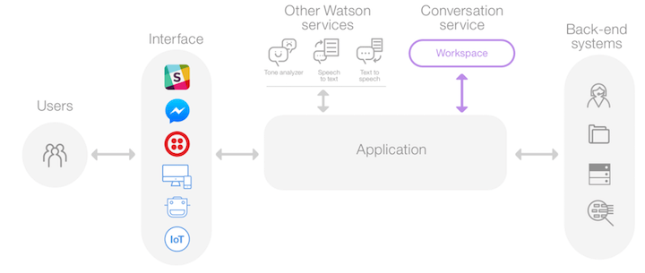
Idea Description(Short)
Architecture Diagram
User visits a website/invokes slack channel with the COVID-19 chatbot and asks a question.
Node.js web server/Slack app calls the Watson Assistant service hosted in IBM Cloud.
Watson Assistant uses natural language understanding and machine learning to extract entities and intents of the user question.
Source COVID-19 FAQ information from trusted CDC/WHO/ Mygov/MOHFW India data.
Watson Assistant invokes an OpenWhisk open source powered IBM Cloud Function.
IBM Cloud Function calls the Watson Discovery service running in IBM Cloud.
Watson Discovery scans news articles and responds with relevant articles
Watson Assistant invokes an OpenWhisk open source powered IBM Cloud Function.
IBM Cloud Function calls the different API's to get different data in
Watson Assistant replies to the user inquiry.
Node.js web server /Slack app displays the chat answer to the user.
Integration of Chatbot with Slack, Web and Mobile:
Application link on GitHub: https://github.com/ankikapersonal/Read-Reckoner-A-COVID-19-Chatbot-CFC2020
YouTube Video (3 min): https://youtu.be/Kl_aKyTz3bo

Slide 5
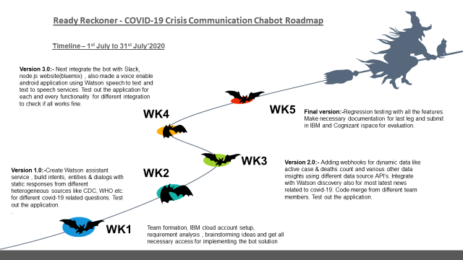
ROADMAP
Scope for Enhancement
Integrate the Chabot to various other additional public data sources ,subject matter expertise & more API’s to create a complete robust solution
Build a real time customized UI with many more interactive features
Integrate the Chabot with iOS

